Slide 1
Stair Climbing Tumbller
DECEMBER 9, 2021
Team 1
Kwadwo Akompong, Xu Mo, Zach Nobles, Shivani Saboo & Yuan Qian

Slide 2

Introduction

Slide 3
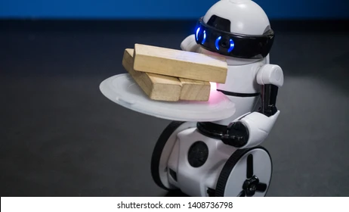
Problem Statement
In conjunction to the pandemic as well as rising labor shortage there is an increased need for automated workers.
A two wheeled self balancing robot has the unique advantage of occupying minimal floor space and yet being reliable. A most common application is to carry material back and forth.
Most research in applications of two-wheel robot assume a level floor. This limits the scope of applications. A common ‘disturbance’ in environment are steps. This is also the motivation for our project
To develop control that enables a self-balancing robot to climb a step while balancing external weight.

Slide 4
Methodology

Slide 5
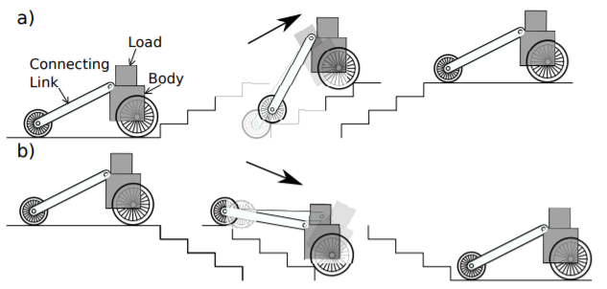
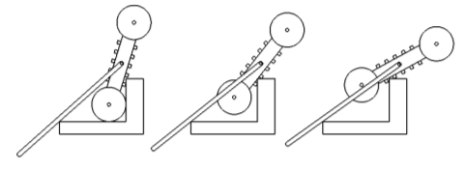
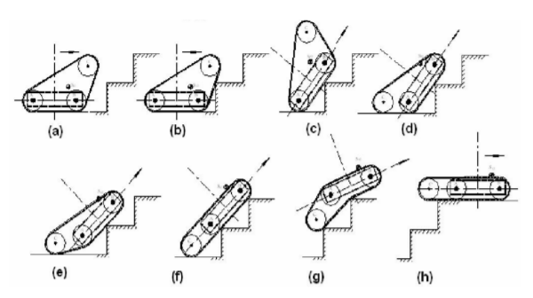
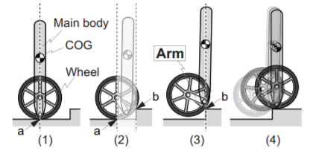
Existing Methods
Below are examples of robots and methods of getting them over stairs.

Slide 6
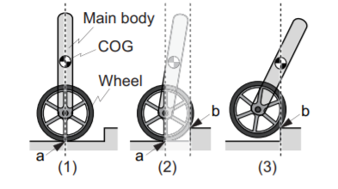
Existing Methods
Following are some of the existing methods used for step ascension and weight balancing
J. X. J. Bannwarth, et al used an auxiliary reaction wheel actuator along with a mathematical model of step ascent to create a feedback linearisation controller.
S.T.Chen et al used equations of motion of the system and designed a controller considering the initial conditions and possible reference trajectories. They used full state feedback. They also found that point of linearisation had a great influence on the control and that roll-back was minimized when the system was linearised about the equilibrium point at the base of the step. They got results of 0.196m radius wheel climbs a 5.7cm step
[1] S. T. Chen, P. Hazelwood, and K. A. Stol, “Step Ascent Modelling of a Two-Wheeled Robot”
[2] J. X. J. Bannwarth, C. Munster and K. A. Stol ‘Step Ascension of a Two-Wheeled Robot using Feedback Linearisation’

Slide 7
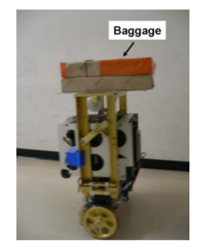
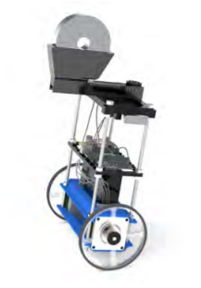
Existing Methods
Following are some of the existing methods used for weight balancing
T. Takei et al created automatic baggage transportation system with two cooperative subsystems: a balancing-and-traveling control subsystem and a navigation subsystem. Change in center of gravity by a loaded baggage is considered when applying the linear state feedback control method for balancing and traveling.
Fredrik Ihrfelt et al achieved balance by using a PID controller with inputs from a gyroscope and accelerometer.
[3] T. Takei, R. Imamura, and S. Yuta, “Baggage transportation and navigation by a wheeled inverted pendulum mobile robot,”
[4] Fredrik Ihrfelt and William Marin, “WiFi steerable self-balancing robot. “

Slide 8
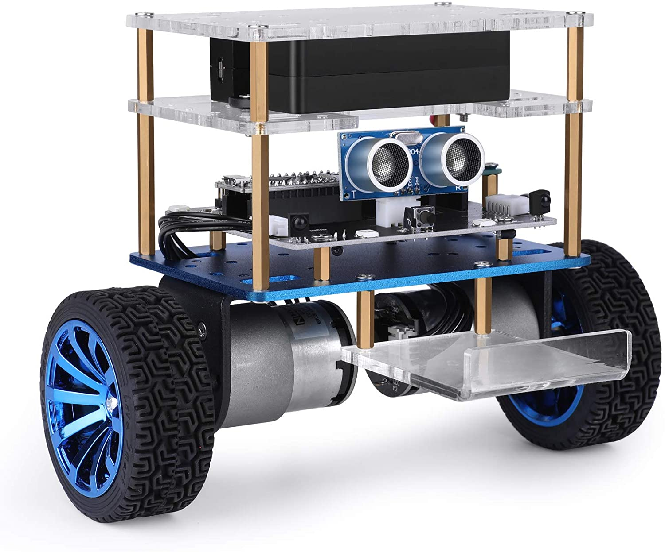
Adopted Methodology
We will keep the simple cart-pole, or inverted pendulum, structure and choose not to make any modifications to it.
The idea is to build control robust enough to reject the disturbance of a step in the path
To do this we improved upon the base PID controller of the tumbler and also designed LQR control

Slide 9
Simulation

Slide 10
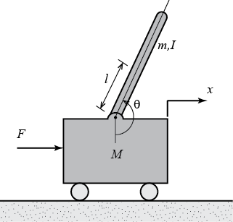
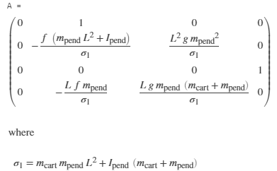
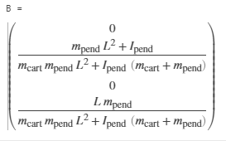
System Modeling
We built both linearized and non-linear models.
The linearized model is better for designing the control algorithm since it’s convenient to design poles.
We do need non-linear model for testing since it is much closer to the real-world dynamics.

Slide 11
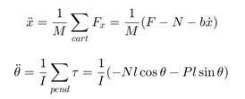
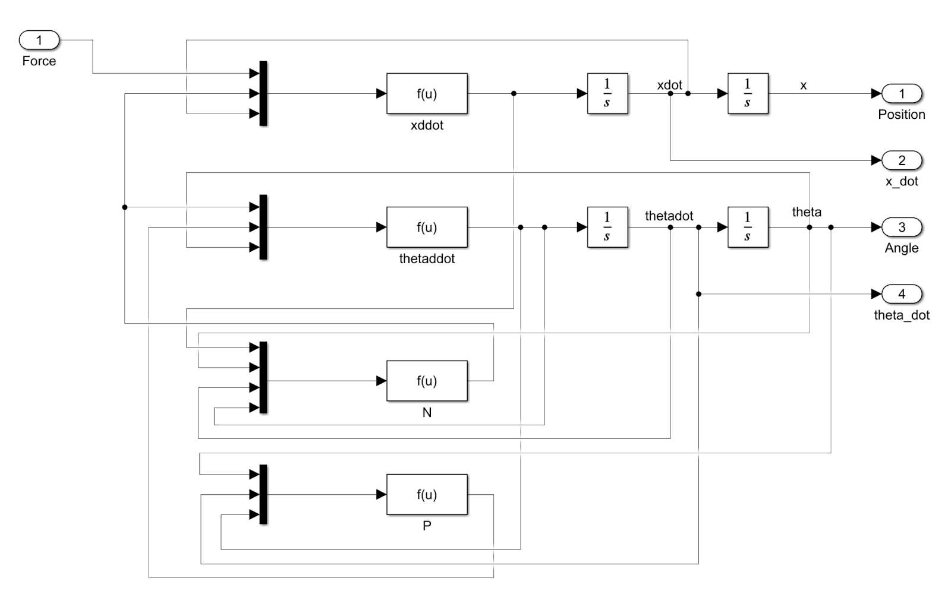
System Modeling - Simulation Non-Linear
non-linear model

Slide 12
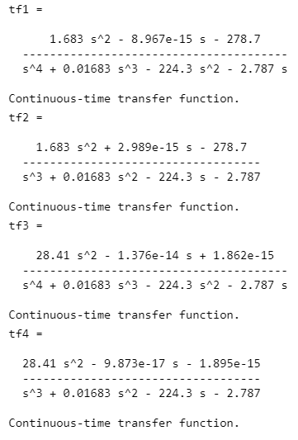
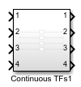
System Modeling - Simulation Linear

Slide 13
Control Design

Slide 14
Control Design
Our controller was heavily inspired by cordyceps
Cordyceps is a fungus that lives on certain caterpillars in the high mountain regions of China. Most cordyceps supplements are made in a lab.
Cordyceps might improve immunity by stimulating cells and specific chemicals in the immune system. It might also help fight cancer cells and shrink tumor size, particularly with lung or skin cancers. Natural cordyceps is hard to get and might be expensive.
People most commonly use cordyceps for athletic performance, kidney disorders, liver problems, and sexual problems, but there is no good scientific evidence to support these uses.

Slide 15
Control Design-PID
For the PID controller we found two independent gains for angle and speed controls.
The angle control updates every 5ms, whiles the speed control updates every 40ms
Our PID gains for balance is very similar to the base but we changed the PID gains for speed to suit step climbing better

Slide 16
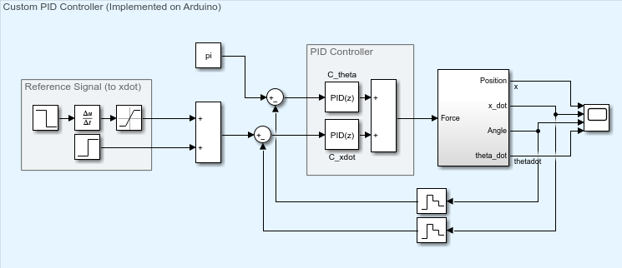
Control Design-PID

Slide 17
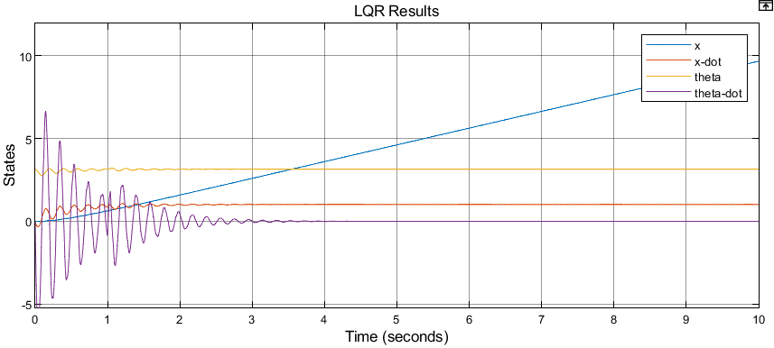
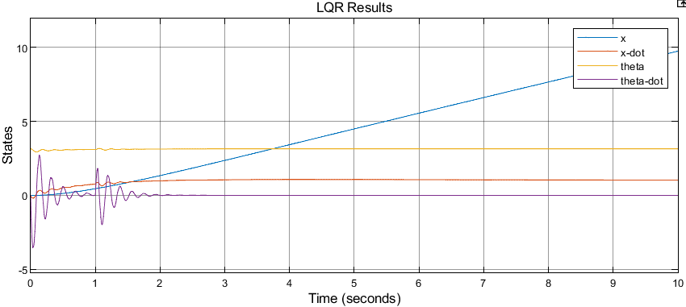
Control Design-PID

Slide 18
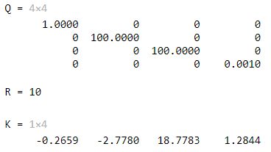
Control Design-LQR
The Q and R matrix we used for LQR are as follows
Which led to the K matrix being

Slide 19
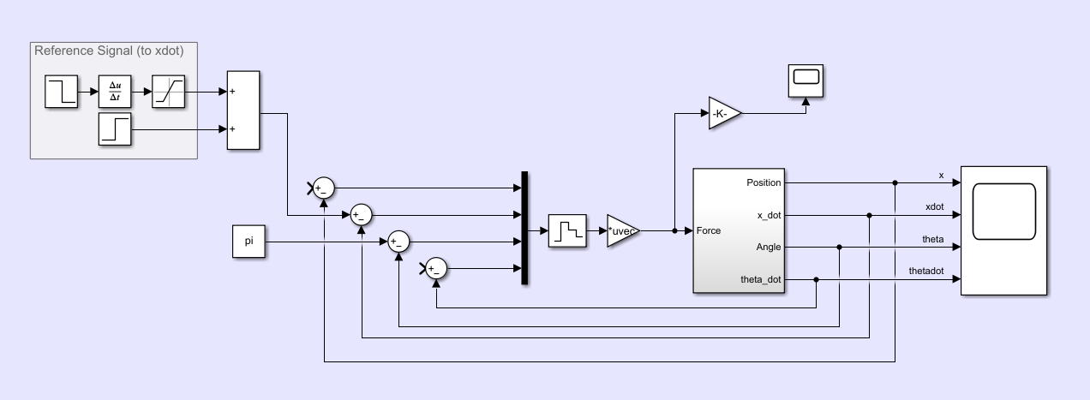
Control Design-LQR

Slide 20
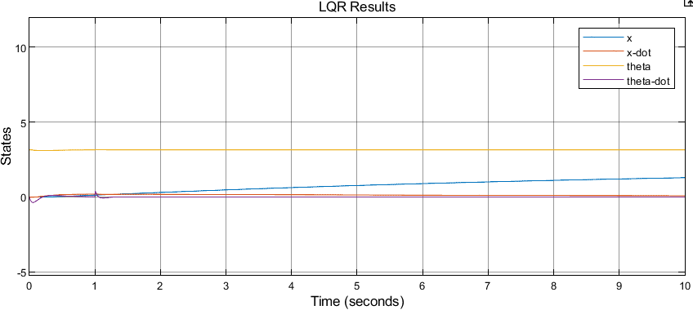
Control Design-LQR

Slide 21
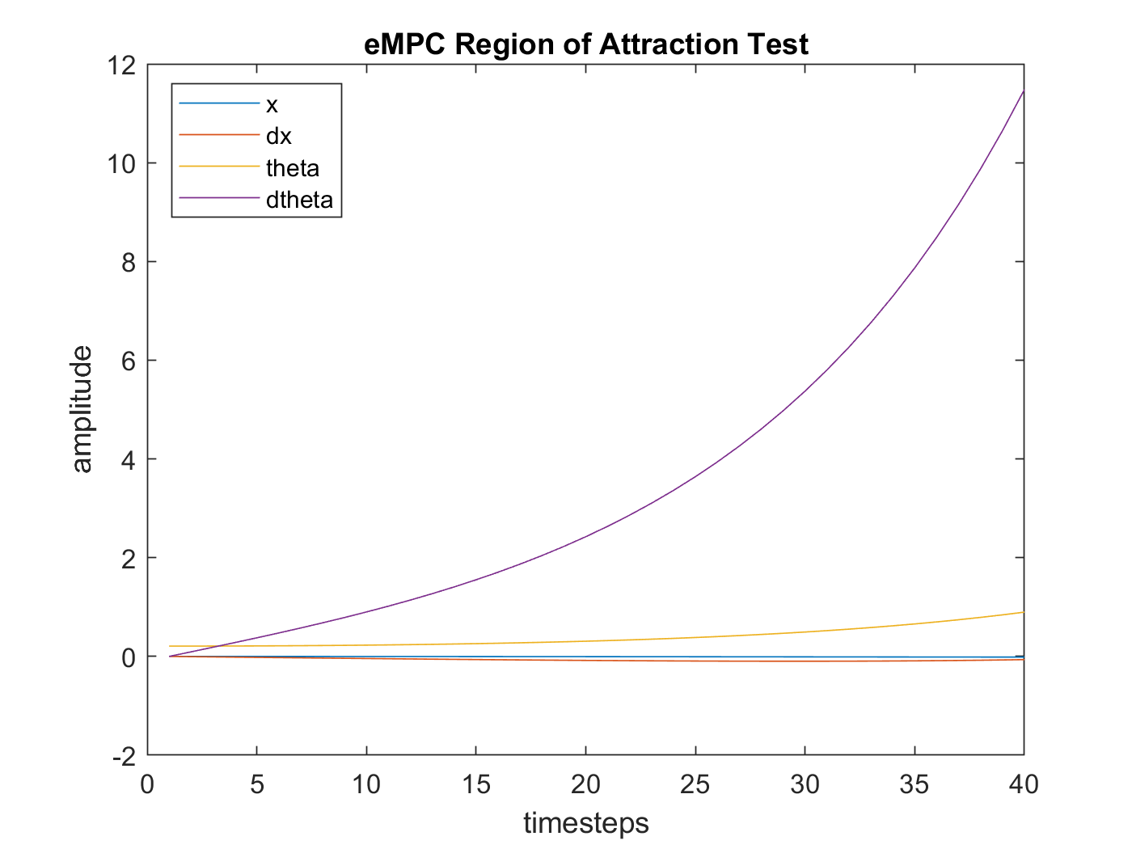
Control Design-eMPC
The Tumbller system is capable of executing a real time eMPC with a prediction horizon of 2 timesteps.
For the system to be controlled fully by one eMPC, a prediction horizon of >100 would be required.
Full eMPC control was deemed infeasible

Slide 22
Hardware

Slide 23
Hardware
Our control algorithms are embedded into C and run through an arduino nano.
We call an interrupt every 5ms to gather the states and update the command voltage.
We get the robot state from mpu and with Kalman Filter we calculate the estimated angle value.

Slide 24
Hardware - States
We obtained our x position by multiplying the encoder counts of our wheels by the circumference ratio.
We obtained our velocity by performing a low-pass filter derivative on the x-position. We found the cut-off frequency of 30Hz through experimentation
.

Slide 25
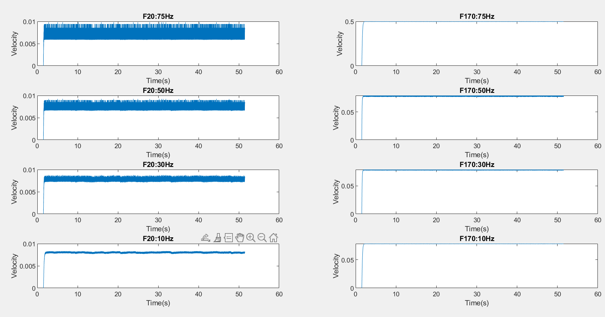

Slide 26
Hardware - States
We obtained our theta position by using the premade kalman filter designed by the
We obtained our angular velocity by performing another low-pass filter derivative of 50Hz.

Slide 27
Demo Videos

Slide 28

Videos

Slide 29

PID Balance

Slide 30
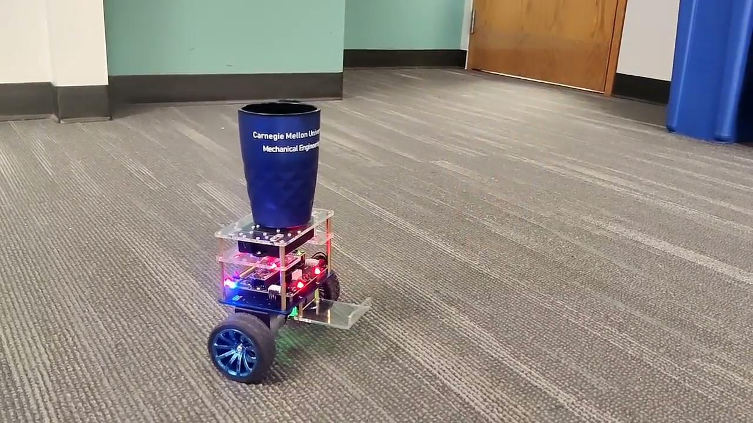
LQR Balance

Slide 31
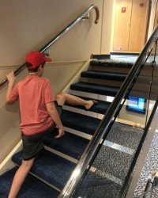
US
STEPS W WEIGHTS
STEPS
MINOR OBSTACLES
UNEVEN SURFACE
BALANCING WEIGHTS
BALANCING

Slide 32
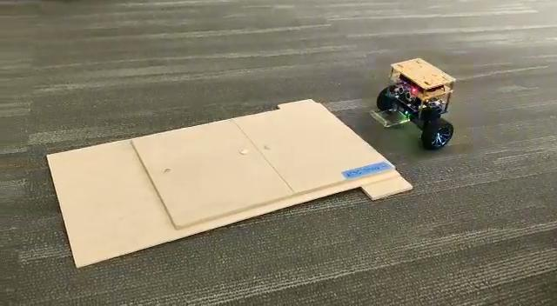
PID Step

Slide 33
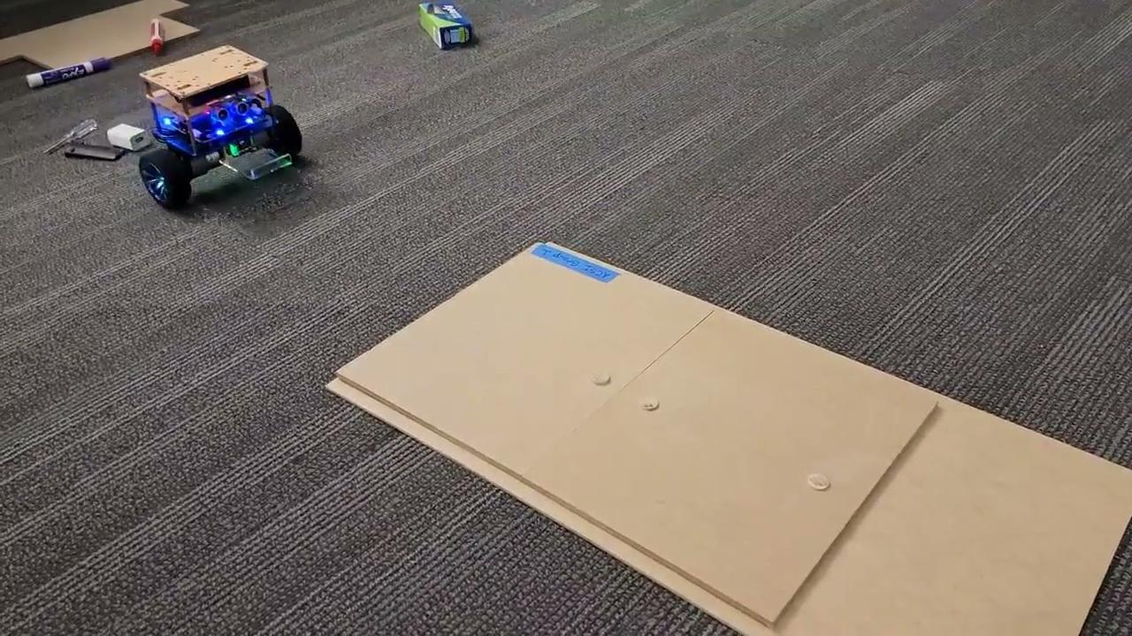
LQR Step

Slide 34
PID Weights

Slide 35
LQR Weights

Slide 36
Results Analysis
climbing step height | baseline codes (inch) | our codes (inch)
PID | 0.5 | 0.625
LQR | 0.5 | 0.625 (almost 0.75)
The performance of both our codes is 25% better than the baseline codes.
We climb 24% of our wheel dia while the baseline paper we were following did 14% of wheel dia

Slide 37
Demo Shortcoming
The consistency of the climbing movement still has some room to improve.
There are certain requirements for the surface condition of the climbing step.

Slide 38
Any comments, questions, or suggestions?

